Slide 1
The Art of West Africa
Kente Cloth

Slide 2
Kente is a cloth that is woven by the Asanti people of Ghana in West Africa.
Its history dates back to the Ashanti kingdom of the seventeenth century.

Slide 3
Legend says two brothers went hunting and saw a spider spinning web. It looked beautiful, and triggered them to make a cloth similar to the spider web.

Slide 4
The word “kente” comes from the word “kenten,” which means basket.
The first kente weavers used raffia or palm leaf fibers, and wove them into a cloth that looked like a basket.

Slide 5
The traditional colors used by the Ashanti people were yellow, blue, green and red colors. Weavers used seeds and barks from the local trees to make dyes. They would soak fibers in the dyes then weave them to produce beautiful fabrics.

Slide 6
Kente cloth was also associated with the Ashanti royalty and was therefore made from a very expensive silk which was imported to Ashanti kingdom through the global trade route which stretched from West Africa, through Sahara to the Middle East and Asia from Europe. The Ashanti people imported the fabric through this route using caravans of Camels.

Slide 7
The Ashanti people would not allow women to make the cloth because it was believed that their menstrual cycle would affect the cloth production.

Slide 8
In the present day kente fabric has become very popular to tourists who buy Kente inspired cloth, shoes and bags when they tour Ghana.
However, kente remains a symbolic representation of the origin of the Ashanti people.

Slide 9
Kente cloth weaves together the art, history, religion, music, dance, wisdom, values, and spirit of a people. Worn by people all around the world, these special fabrics give meaning to the modern clothes we wear today. Kente helps to bind the past to the present, bringing people of different cultures together in respect.
-Kwaku Ofori-Ansa
Professor of African Art History
Howard University.

Slide 10
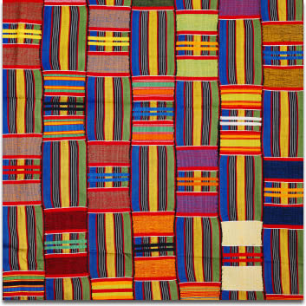

Slide 11
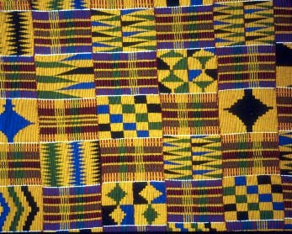

Slide 12
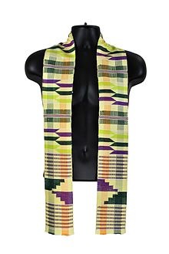

Slide 13
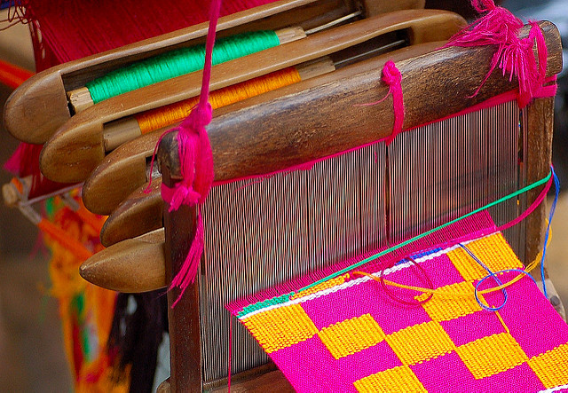

Slide 14
FACTS:

Slide 15
Kente (“KEN-tay”) is considered to be the most famous of all African textiles.
This cloth is special as it is worn as a piece of clothing and each pattern design has a name and a special meaning.
The origin of kente cloth is sometimes said to date back to the 12th century but the exact date is unknown.
In the past, royalty and important figures of society wore this cloth for very special occasions. Today, kente cloth is worn by people of all social status.

Slide 16
Each cloth design has a deep symbolic meaning and is used to provide a social and political commentary.
It is also a visual representation of moral, social, ethical, philosophical values, history, social code of conduct and religious beliefs.
Moreover, the choice of colors is significant in each design, as each color also is symbolical.

