Slide 1
DRAGON EYE
Color Pencil Technique

Slide 2
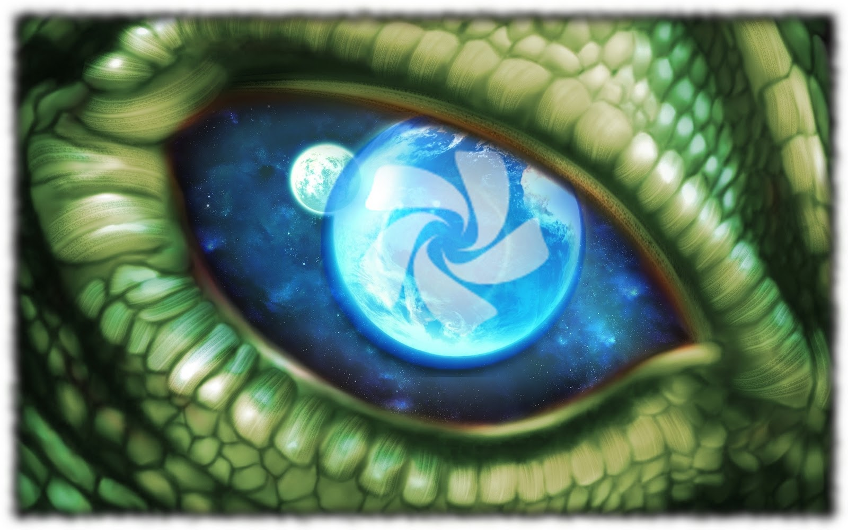

Slide 3
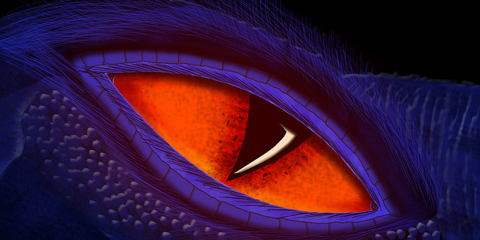

Slide 4
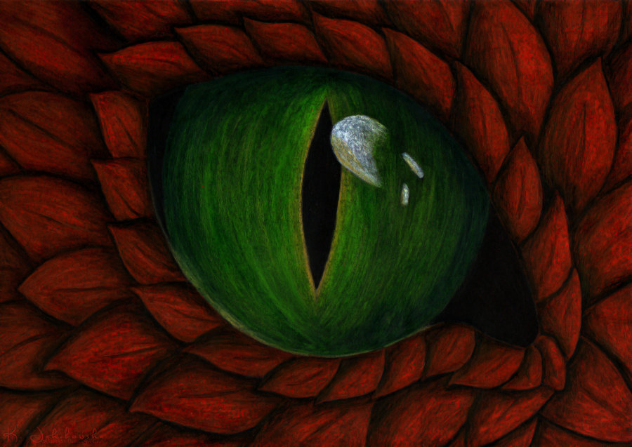

Slide 5
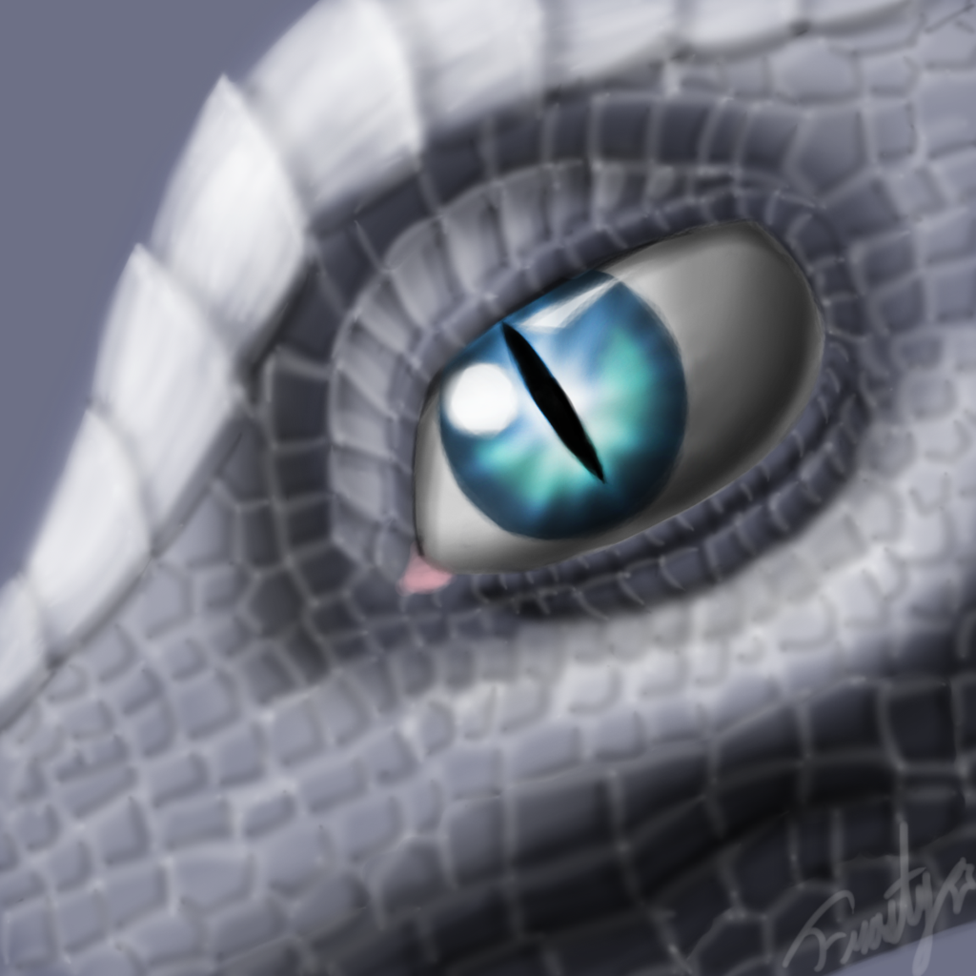

Slide 6
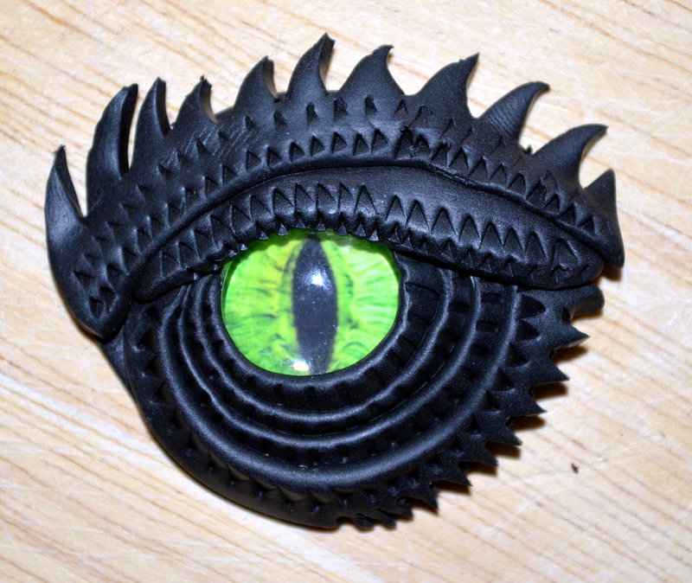

Slide 7
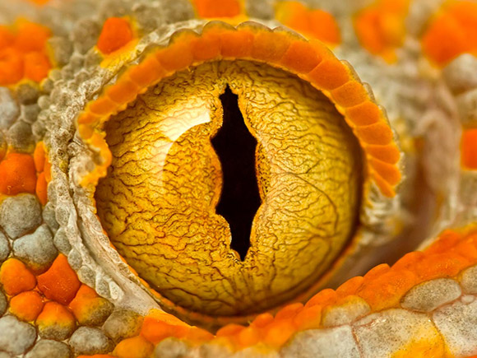

Slide 8
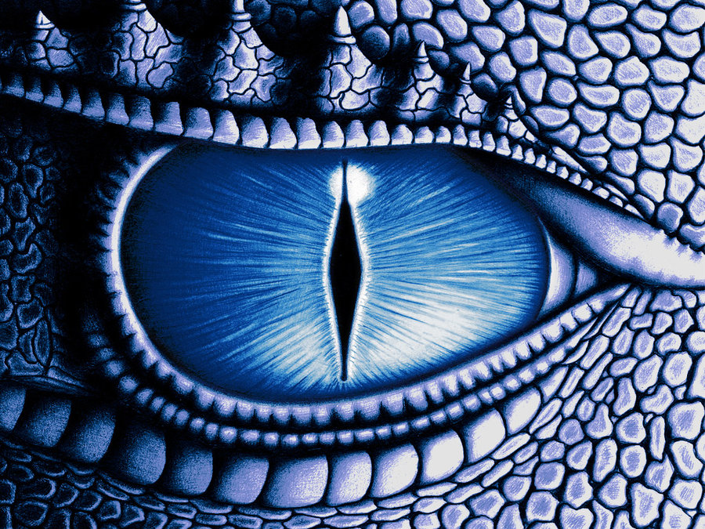

Slide 9
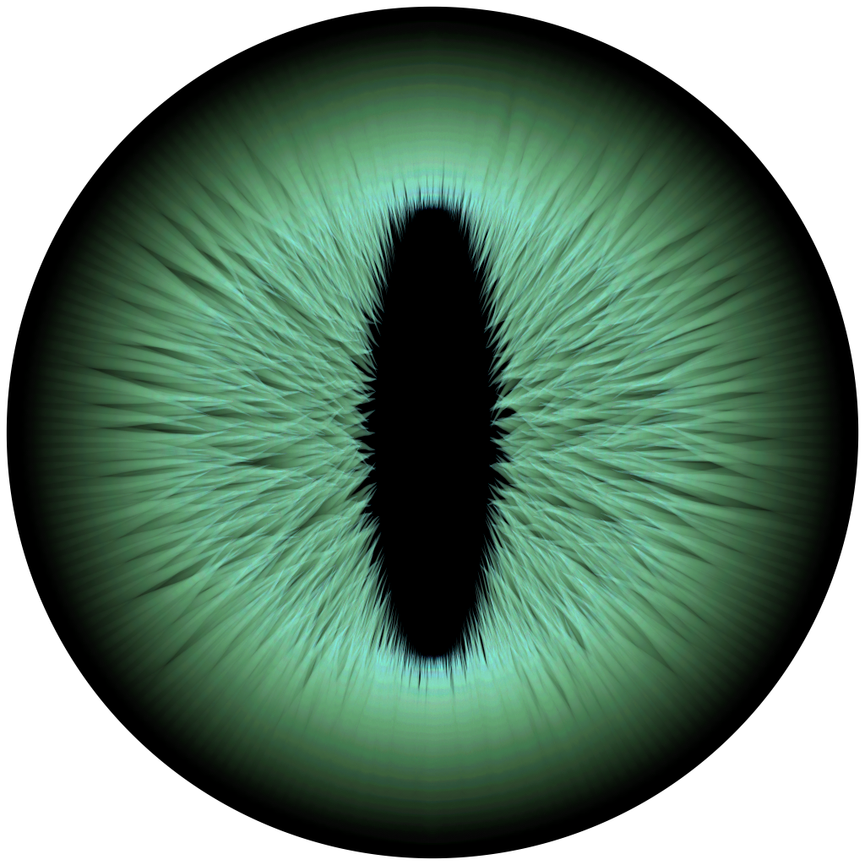

Slide 10
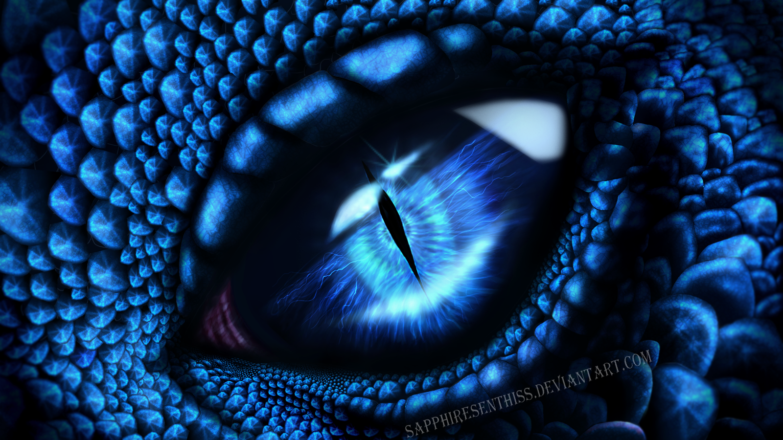

Slide 11
What did you notice about the eyes?
Are they alike in some ways?
Are they different in some ways?
What did you notice about the colors?
Are they scientifically accurate?
What are some common characteristics of the eyes?

Slide 12

Color Pencil

Slide 13
What is a color pencil?
A colored pencil, or coloured pencil, or pencil crayon is an art medium constructed of a narrow, pigmented core encased in a wooden cylindrical case. Unlike graphite and charcoal pencils, colored pencils’ cores are wax-or oil-based and contain varying proportions of pigments, and binding agents.

Slide 14
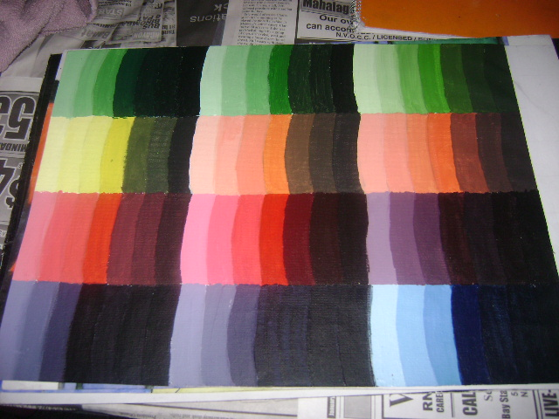
Color Gradation

Slide 15
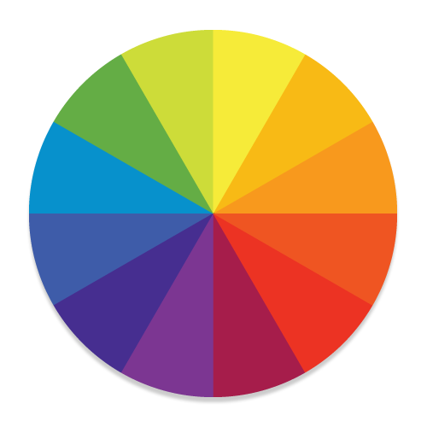
What are the neighboring colors?

Slide 16
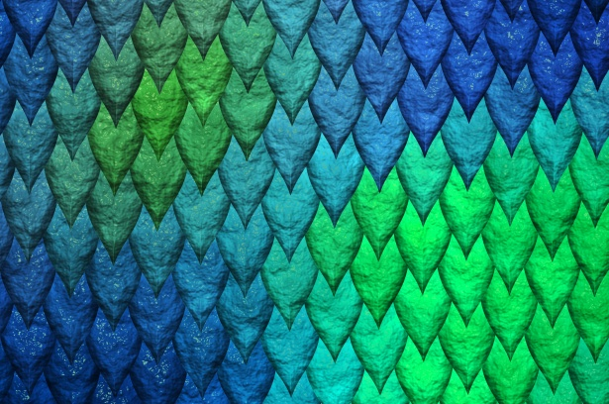
Reptilian Scales

Slide 17
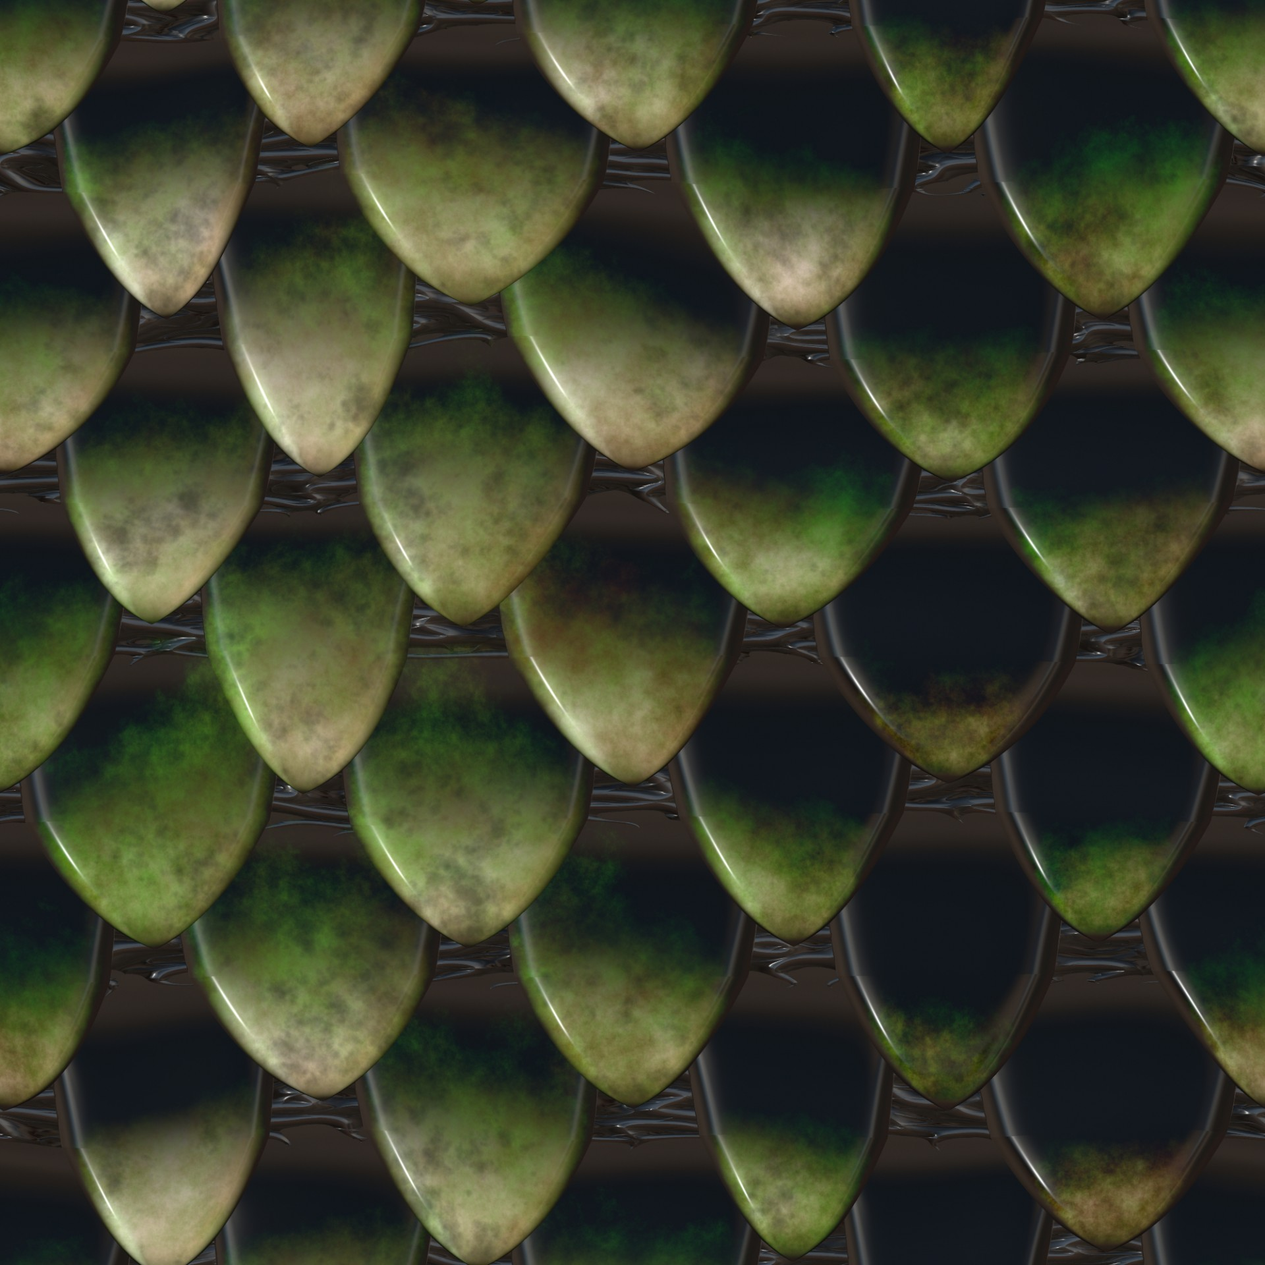

Slide 18
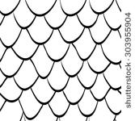

Slide 19
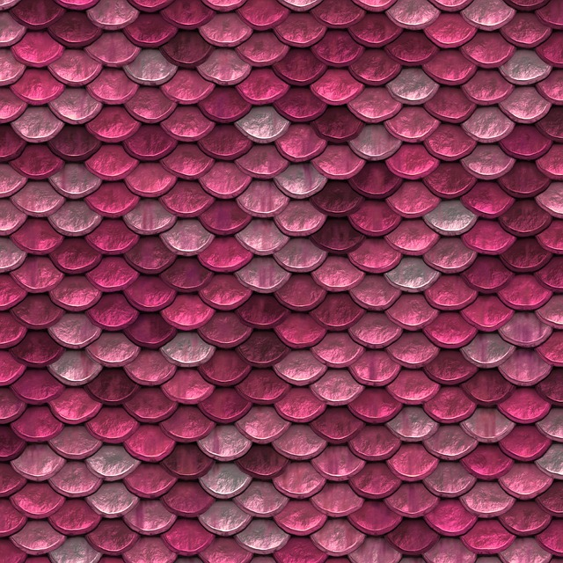

Slide 20


Slide 21
What is a dragon?
a mythical monster like a giant reptile. In European tradition the dragon is typically fire-breathing and tends to symbolize chaos or evil, whereas in East Asia it is usually a beneficent symbol of fertility, associated with water and the heavens.

